Slide 1
Interim Project Presentation Cloud based vehicle to vehicle communication for traffic monitoring Programme : B.Tech in CSE

Slide 2
Group Details
Sl.No. | Reg. No. | Name of the student | Department
1 | 16ETCS002092 | PREETI S MATHPATI | CSE
2 | 16ETCS002005 | AKSHATA C HUDED | CSE
3 | 16ETCS002065 | LAVANYA | CSE
4 | 16ETCS002134 | SWAROOPA | CSE
5 | 16ETCS002123 | SHREE LAKSHMI.N | CSE
Batch : FT - 2016

Slide 3
Title of the Project
Cloud based vehicle to vehicle communication for
traffic monitoring
Supervisors
Supervisor 1: Mr. Nithin Rao.R
Place of Work : Ramaiah University Of Applied Sciences

Slide 4
Outline
Introduction
Motivation(Project Concept and its relevance)
Aims and Objectives
Title, Aim, Objectives, Methods and Methodology
Problem Solving
Project Concept, Design, Implementation
Project Costing
Expected outcomes
Workload Allocation
Updated Gantt chart with separate coloring for completed work
References
Demonstration (If applicable)
Team Experience

Slide 5
Introduction
In vehicle to vehicle communication project, the vehicles send the information about the traffic and other circumstances on that particular area to the cloud which can be accessed by other vehicles moving to that same location. Using the information in the cloud, the vehicle can take a safer and smoother way to reach their destination.

Slide 6
Motivation (Project Concept and its relevance)
Vehicle to vehicle communication is growing field in present era.
Congestion control has become a major issue due to increase in number of on road vehicles. It can be controlled if the traffic updates can be known in prior.
The cloud computing plays a major role for implementing the smart traffic monitoring system, as it helps in sharing resources to all vehicles in a network.
This concept aims at increased driving comfort, public safety and avoid potential hazards from other vehicles.

Slide 7
Title
Cloud based vehicle to vehicle communication for traffic monitoring

Slide 8
Aim
To design and develop a system which enables vehicle to vehicle communication through cloud in order to avoid traffic congestion.

Slide 9
Objectives
To conduct the literature survey on cloud based vehicle to vehicle communication, GPS based navigation and related techniques and methodologies.
To analyze the literature survey and arrive at the system requirements for cloud based vehicle to vehicle communication.
To arrive at design specification of the system based on the identified requirements and design subsystems like cloud, On-board diagnostics(OBD) and User interface.
To develop the hardware circuitry which includes microcontroller, GPS, sensors and Wi-fi module.

Slide 10
Objectives
5. To develop an user interface through appropriate software tools.
6. To test and validate the developed system for various cases considered and incorporate necessary changes.
7. To document the report by unifying all the results and outcomes.

Slide 11
Methods and Methodology
To conduct the literature survey on cloud based vehicle to vehicle communication, GPS based navigation and related techniques and methodologies.
1.1 To review the literature on existing cloud based vehicle to vehicle communication, their working, functionality and hardware used from peer reviewed journals, reference books and other authentic sources.
1.2 The Literature will be reviewed critically and various methods used for developing cloud based vehicle to vehicle communication will be summarized.

Slide 12
Methods and Methodology
To analyze the literature survey and arrive at the system requirements for cloud based vehicle to vehicle communication
2.1 Based on the characteristics identified in the survey, a generic list of requirements for a cloud based vehicle to vehicle communication will be penned down.
2.2 The functional and non-functional requirements of the cloud based vehicle to vehicle communication will be derived.
2.3 The dependency between the functional requirements will be identified.
2.4 The requirements identified for the system will be checked for the feasibility.

Slide 13
Methods and Methodology
To arrive at design specification of the system based on the identified requirements and design subsystems like cloud, On-board diagnostics(OBD) and User interface.
3.1 Based on the requirements identified, a high level block diagram will be developed.
3.2 Microcontroller, wifi-module and other peripherals which satisfy the functionality and be compatible with each other will be identified.
3.3 A low level block diagram and flowchart will be developed to achieve the required functionality.
3.4 To establish relation between the identified subsystems.

Slide 14
Methods and Methodology
To develop the hardware circuitry which includes microcontroller, GPS, sensors and Wi-fi module.
4.1 Appropriate IDE will be selected and Software implementation for each sub-system will be done.
4.2 Hardware components like microcontroller, wi-fi module, sensors, actuators are connected to build the hardware solution.
4.3 Hardware and software implementation are integrated in order to develop a fully functional system as per the requirements.

Slide 15
Methods and Methodology
To develop an user interface through appropriate software tools
5.1 An appropriate software tool to develop the UI will be identified.
5.2 The home screen, menu and sub-menus required will be designed.
5.3 The required data from the cloud will be extracted and necessary actions will be performed

Slide 16
Methods and Methodology
To test and validate the developed system for various cases considered and incorporate necessary changes.
6.1 The developed application will be tested for different cases considered.
6.2 Test cases for unit, integration and functional testing will be developed.
6.3 The expected outcome and the actual outcome will be validated.
6.4 Based on the results, obtained changes will be incorporated if required.

Slide 17
Methods and Methodology
To document the report by unifying all the results and outcomes
7.1 A scientific project report as per the university template will be developed.
7.2 The design, implementation, verification, testing and validation, results of this system are reported.
7.3 Analyze performance of the application and report the performance test results.
7.4 Demonstrate the working model of the cloud based vehicle to vehicle communication system.

Slide 18
Problem Solving
Project Concept
Design
Development or Implementation (If applicable)

Slide 19
Problem Solving
FUNCTIONAL REQUIREMENTS:
FR1: System should have main page and optional page.
FR2: System should have log-in/Sign-up in main page and optional buttons like upload and retrieve data in optional page. [FR1]
FR3: System should connect it to cloud.
FR4: System should receive the data by sensor.
FR5: System should able to sense the traffic.
FR6: System should able to send data to the cloud and retrieve the data from the cloud.

Slide 20
Problem Solving
FUNCTIONAL REQUIREMENTS
FR7: System should disable the notification as soon as the vehicle is out of certain range of traffic
FR8: System should be able to receive the data and store it database once it is received.

Slide 21
Problem Solving
NON-FUNCTIONAL REQUIREMENTS
NF1: Safe: The system should be safe and should not cause any harm to the customer.
NF2: Secure: Full security should be provided to customers to prevent any mishaps.
NF3: Fast Processing: Data of the traffic condition on the road at that specific area should be sent and received respectively quickly without much delay.
NF4: Reliability: The system should be reliable, it should send as well as receive correct data.

Slide 22
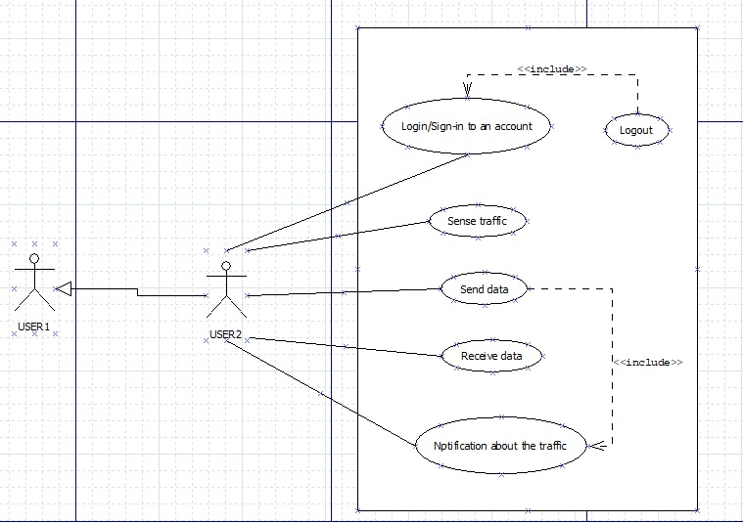
Problem Solving
APP USE CASE DIAGRAM

Slide 23
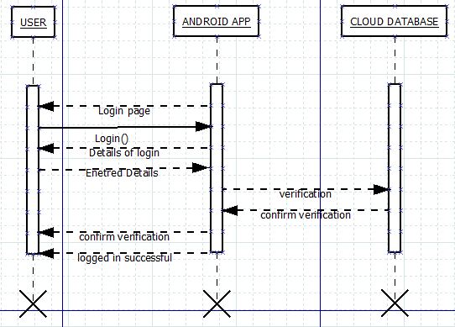
Problem Solving
SEQUENCE DIAGRAM 1: LOGIN PAGE

Slide 24
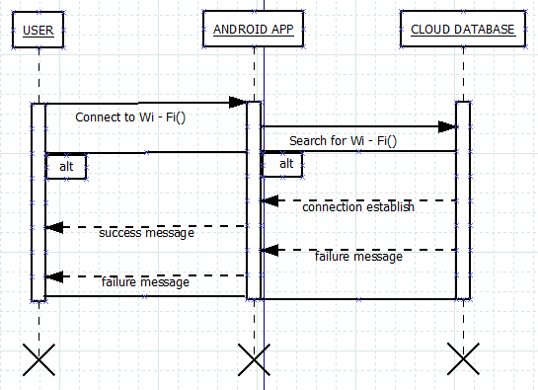
Problem Solving
SEQUENCE DIAGRAM 2: WI -FI CONNECTION

Slide 25
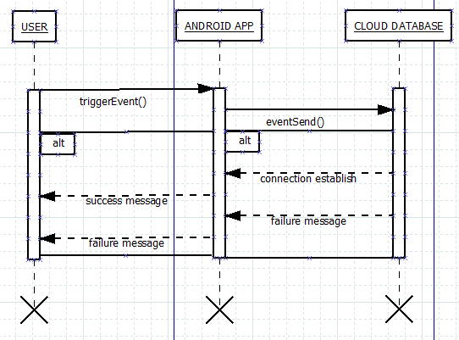
Problem Solving
SEQUENCE DIAGRAM 3: MOVEMENT

Slide 26
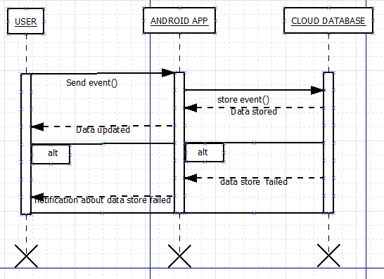
Problem Solving
SEQUENCE DIAGRAM 4: DATA RECORD

Slide 27
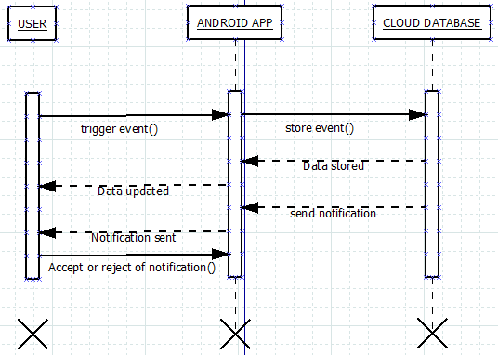
Problem Solving
SEQUENCE DIAGRAM 6: SEND NOTIFICATION MESSAGE

Slide 28
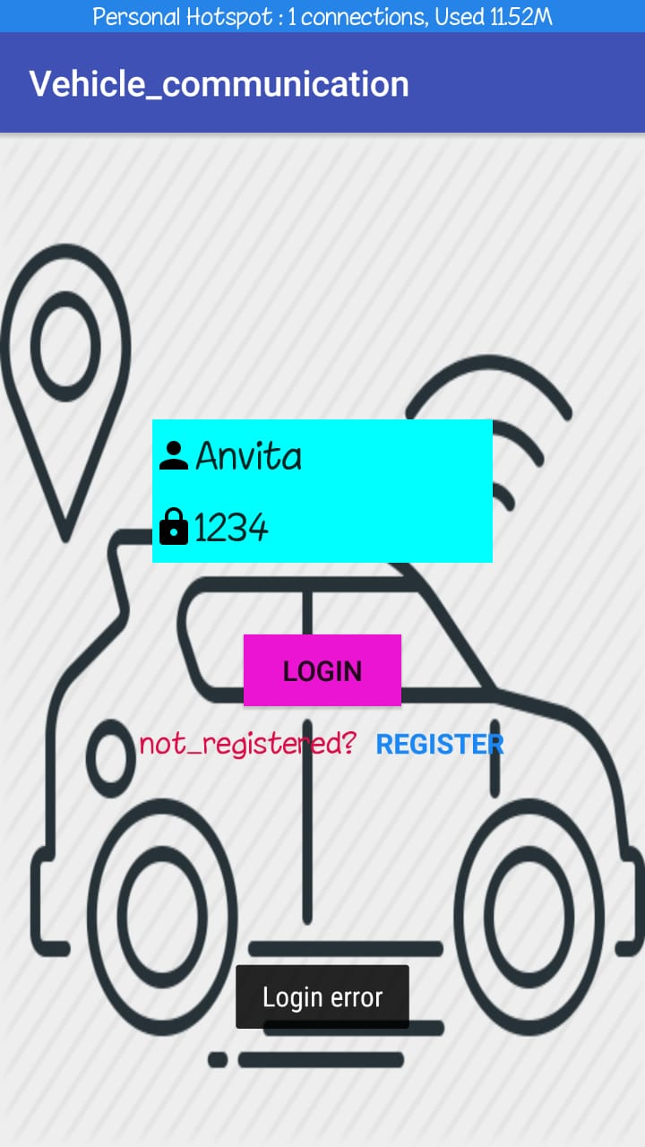
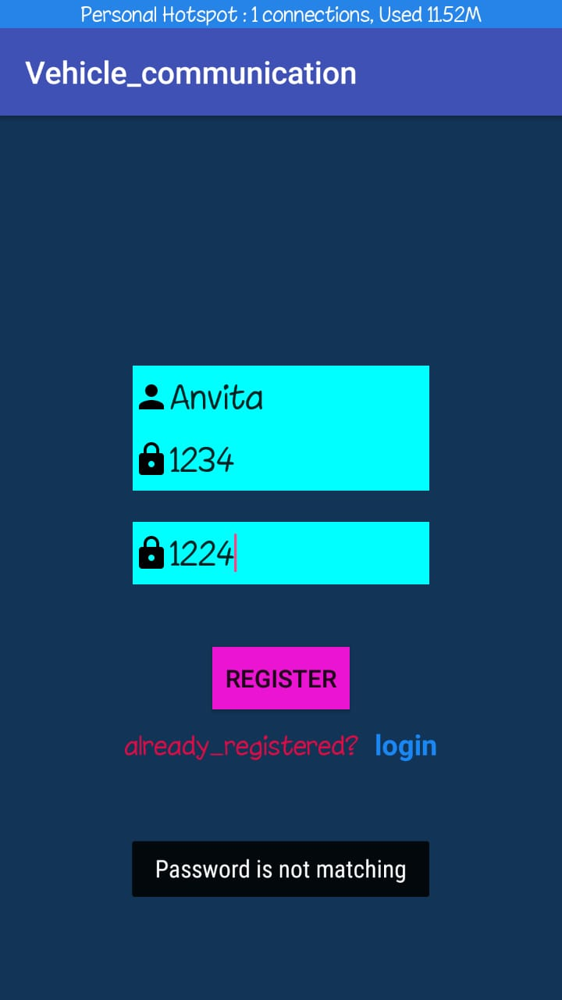
Problem Solving Software Implementation
FIG 1: NEW USER TRIES TO LOG IN WITHOUT REGISTERATION THUS LOGIN ERROR OCCURS
FIG 2: NEW USER IS REGISTERING. COULD NOT REGISTER IF PASSWORD DOES NOT MATCH

Slide 29
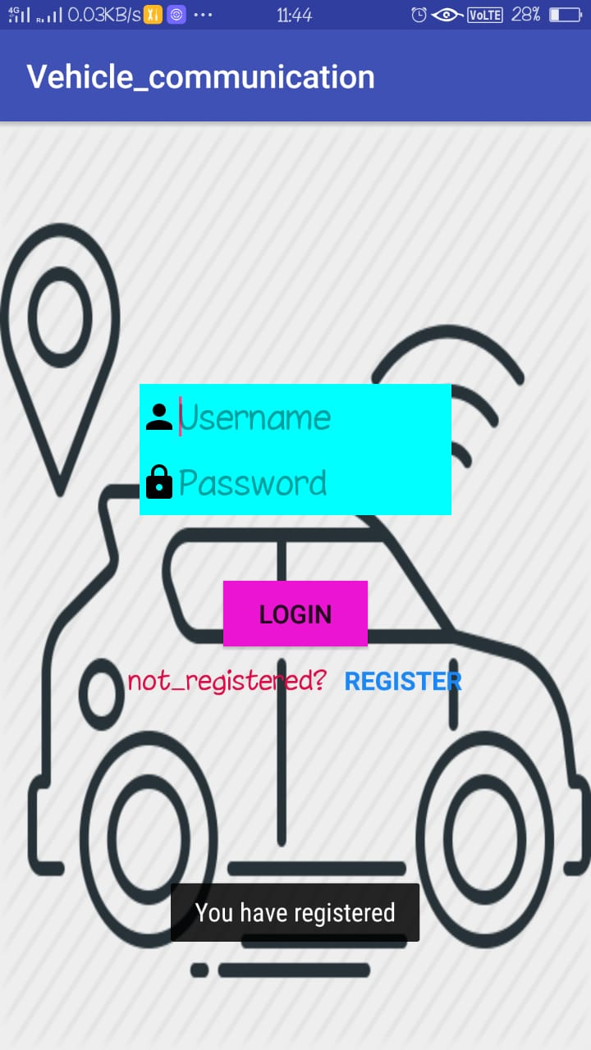
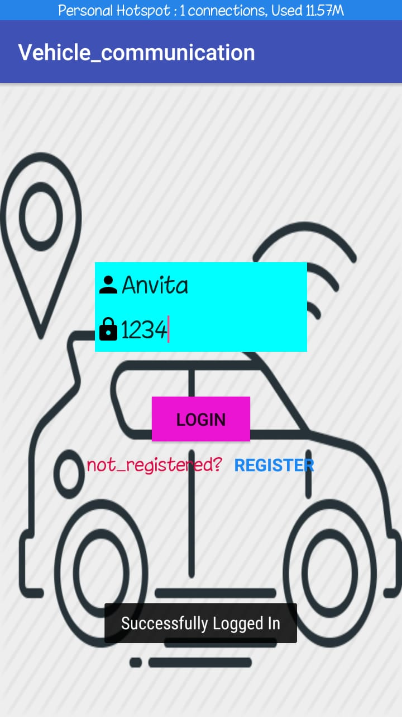
Problem Solving Software Implementation
FIG 3: WHEN PASSWORD MATCH, USER REGISTERS SUCCESSFULLY.
FIG 4: AFTER REGISTRATION, USER CAN LOGIN TO THE SYSTEM

Slide 30
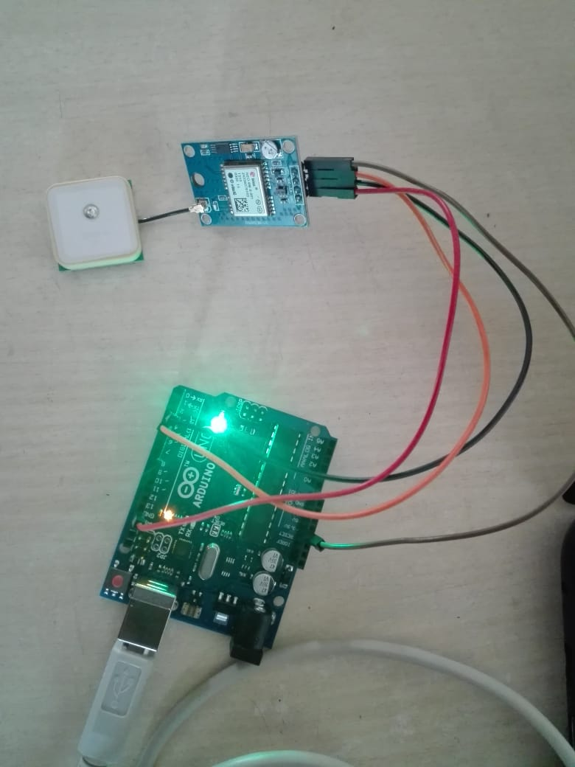
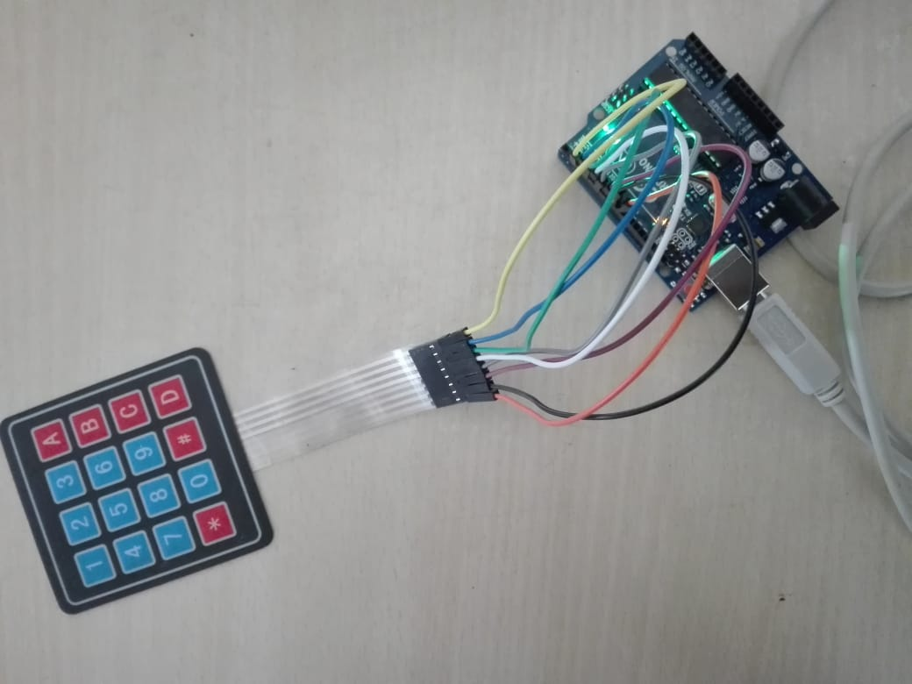
Problem Solving Hardware Implementation
FIG 5: CONNECTION BETWEEN GPS MODEL, MICROCONTROLLER AND ARDUINO
FIG 6: CONNECTION BETWEEN KEYPAD AND ARDUINO

Slide 31
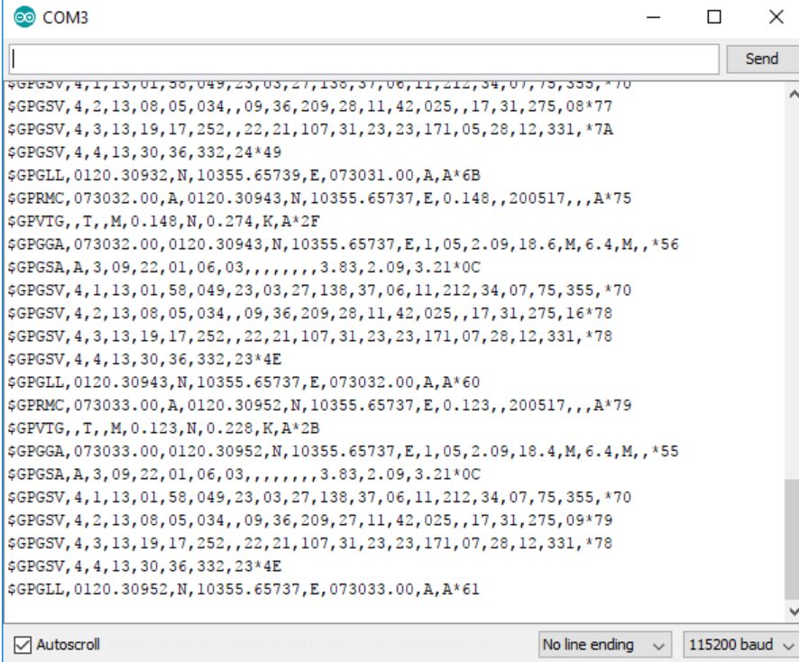
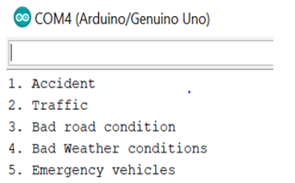
Problem Solving Hardware Implementation
FIG 7: GPS RAW DATA ON SERIAL MONITOR
FIG 8: KEYPAD OPERATION DISPLAY ON SERIAL MONITOR

Slide 32
Expected Outcomes
Demonstration of Working Model
Product Prototype
Conference/ paper publication
Report generation

Slide 33
Project Costing
Sl.no | Work | Cost (₹)
1 | Hardware | 8,000
2 | Software | 0
3 | Report Writing | 0
3 | Human Resources (4x5x30000) | 600,000
 | TOTAL | 6,08,000

Slide 34
Work Load Allocation
Objectives | PREETI S MATHPATI | AKSHATA C.HUDED | LAVANYA | SWAROOPA | SHREE LAKSHMI.N
Analyzing requirements
Design specification
Hardware implementation
Software implementation
Testing
Documenting Report

Slide 35
Updated Gantt Chart
Project Work (UG) 16 weeks
Week | 1 | 2 | 3 | 4 | 5 | 6 | 7 | 8 | 9 | 10 | 11 | 12 | 13 | 14 | 15 | 16
Major Activities

Slide 36
Updated Gantt Chart
Project Work (UG) 16 weeks
Week | 1 | 2 | 3 | 4 | 5 | 6 | 7 | 8 | 9 | 10 | 11 | 12 | 13 | 14 | 15 | 16
Major Activities
1
2
3.1
3.2
3.3
3.4
4
5
6.1
6.2
6.3
6.4
7.1
7.2
7.3
7.4

Slide 37
References
Kolisetty, A., Kristinsson, J.G. and Wisniewski, J., Ford Global Technologies LLC, 2016. Vehicle Operation Based On Activity Tracking. U.S. Patent Application 14/517,256.
Kong, L., Khan, M.K., Wu, F., Chen, G. and Zeng, P., 2017. Millimeter-Wave Wireless Communications for IoT-Cloud Supported Autonomous Vehicles: Overview, Design, and Challenges. IEEE Communications Magazine, 55(1), pp.62-68.
Mekki, T., Jabri, I., Rachedi, A. and ben Jemaa, M., 2017. Vehicular cloud networks: Challenges, architectures, and future directions. Vehicular Communications, 9, pp.268-280.

Slide 38
Team Experience
We had a good experience working in team for the mini project.
We learnt about the hardware and its implementation using Arduino.
We learnt software application development.
Our mentor guidance helped us to develop better understanding of the project.

Slide 39
Thank You

